Slide 1


SQL Troubleshooting: CPU

Slide 2

Part 1: Tools
“The right tool for the right job”

Slide 3

Do I have a CPU issue?
Tell-tale signs your experiencing CPU pressure
High CPU Utilization
Slow SQL Performance
Generally, frequent or sustained levels of above 70% utilization
Slow Windows OS performance
Remote connection issues
Longer query duration
High signal wait time (e.g. 15-20%)
Concurrency issues (i.e. blockings)

Slide 4
First, take an inventory.
Understanding what H/W you’re dealing with and current configuration
SELECT cpu_count AS [Logical CPU Count], scheduler_count,
(socket_count * cores_per_socket) AS [Physical Core Count],
socket_count AS [Socket Count], cores_per_socket, numa_node_count,
physical_memory_kb/1024 AS [Physical Memory (MB)],
max_workers_count AS [Max Workers Count],
affinity_type_desc AS [Affinity Type],
sqlserver_start_time AS [SQL Server Start Time],
DATEDIFF(hour, sqlserver_start_time, GETDATE()) AS [SQL Server Up Time (hrs)],
virtual_machine_type_desc AS [Virtual Machine Type],
softnuma_configuration_desc AS [Soft NUMA Configuration],
sql_memory_model_desc,
container_type_desc
FROM sys.dm_os_sys_info WITH (NOLOCK) OPTION (RECOMPILE);

Slide 5
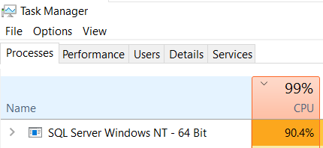
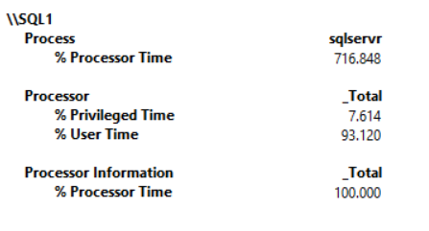
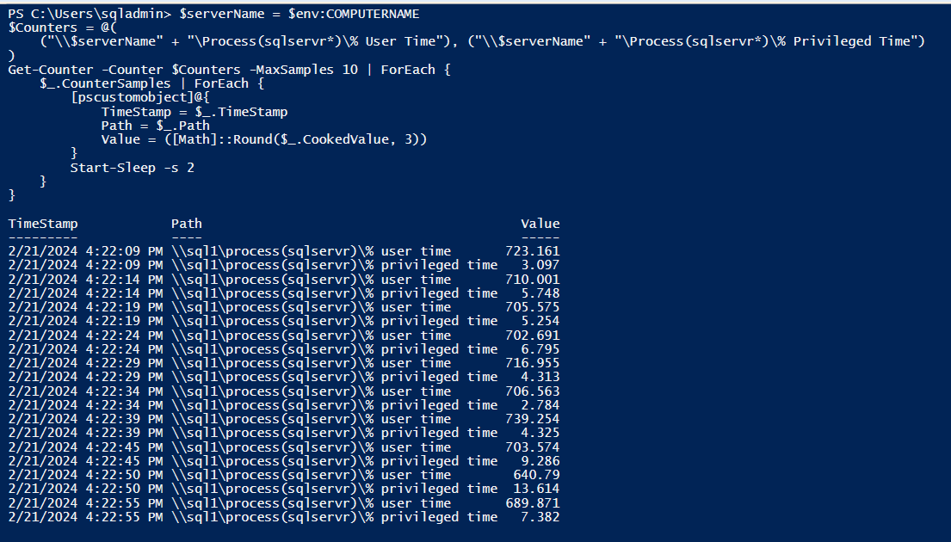

Is it SQL Server?
Verifying if high CPU is caused by SQL Server
Task Manager
PowerShell Script
Current CPU utilization of the SQL process is close to 100%
Capture CPU utilization of SQL process
$serverName = $env:COMPUTERNAME
$Counters = @(
("\\$serverName" + "\Process(sqlservr*)\% User Time"), ("\\$serverName" + "\Process(sqlservr*)\% Privileged Time")
)
Get-Counter -Counter $Counters -MaxSamples 10 | ForEach {
$_.CounterSamples | ForEach {
[pscustomobject]@{
TimeStamp = $_.TimeStamp
Path = $_.Path
Value = ([Math]::Round($_.CookedValue, 3))
}
Start-Sleep -s 2
}
}
Windows PerfMon
Can help validate how much CPU the SQL process is using
The sum of processor time on each process for the threads of the process.
The percentage of time the processor spends on execution of Windows kernel commands(i.e. OS and drive activity)
The percentage of time the processor spends on executing user processes such as SQL Server (including SQL I/O requests)
Across all CPUs. In this example, there are 8 CPUs, so 716.84/8 = 90% CPU usage from the SQL process
If \Processor\% User Time is high (e.g. > 90%) and \Process(sqlservr*)\% Processor Time accounts for most of it, then SQL Server is causing high CPU usage
If \Processor\% Privileged Time is high (e.g. > 90%) then SQL is NOT the cause of high CPU usage. Possible causes are antivirus software, other drivers, OS component, monitoring agents, 3rd party backup clients, etc.

Slide 6
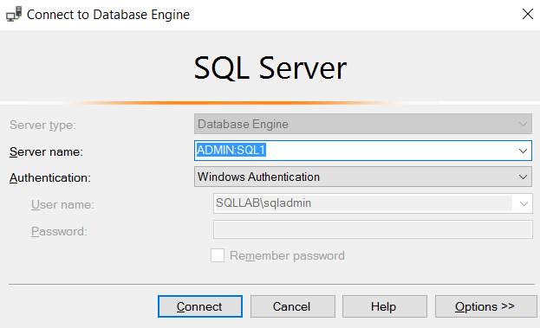
What if you can’t connect to SQL?
“Getting in through the backdoor”
DAC (Dedicated Administrator Connection)
Designed to allow administrators to connect to SQL Server and run diagnostic functions or T-SQL statements in order to troubleshoot problems even when the server is locked or running in an abnormal state, and unable to respond to a regular SQL Server Database Engine connection
Only members of sysadmin role can use DAC
Only one DAC connection is allowed per SQL instance
Has a dedicated CPU scheduler
Allocated only limited resources
Uses port 1434 (also seen in errorlog)

Slide 7
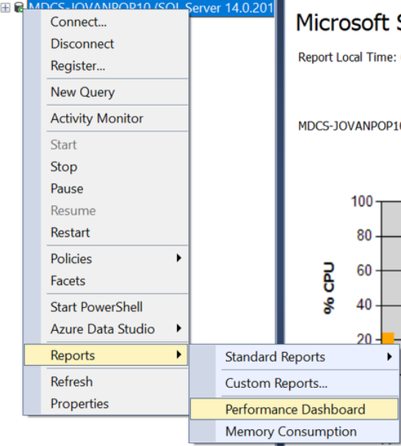
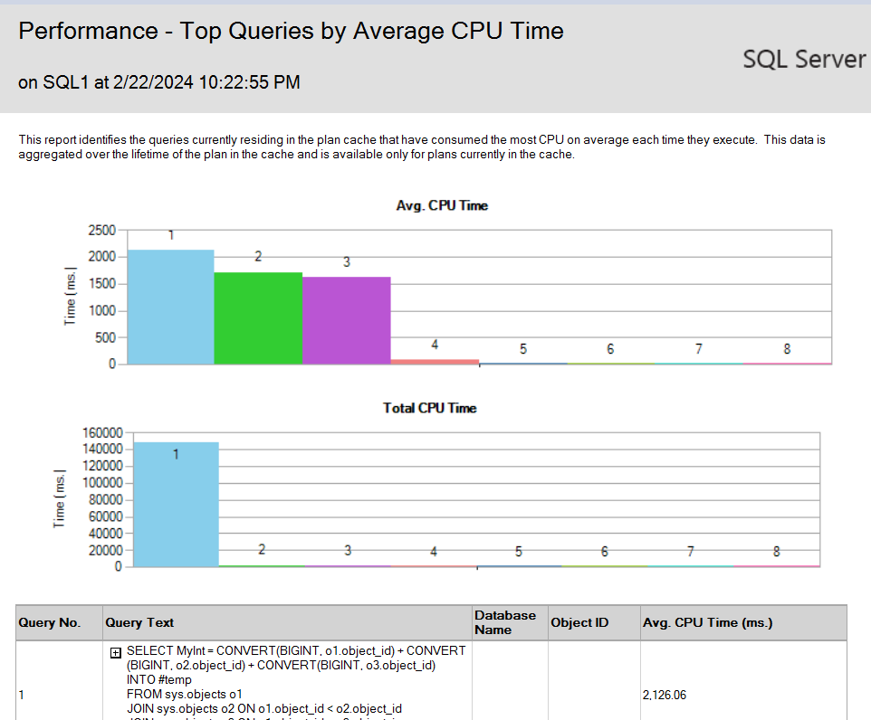
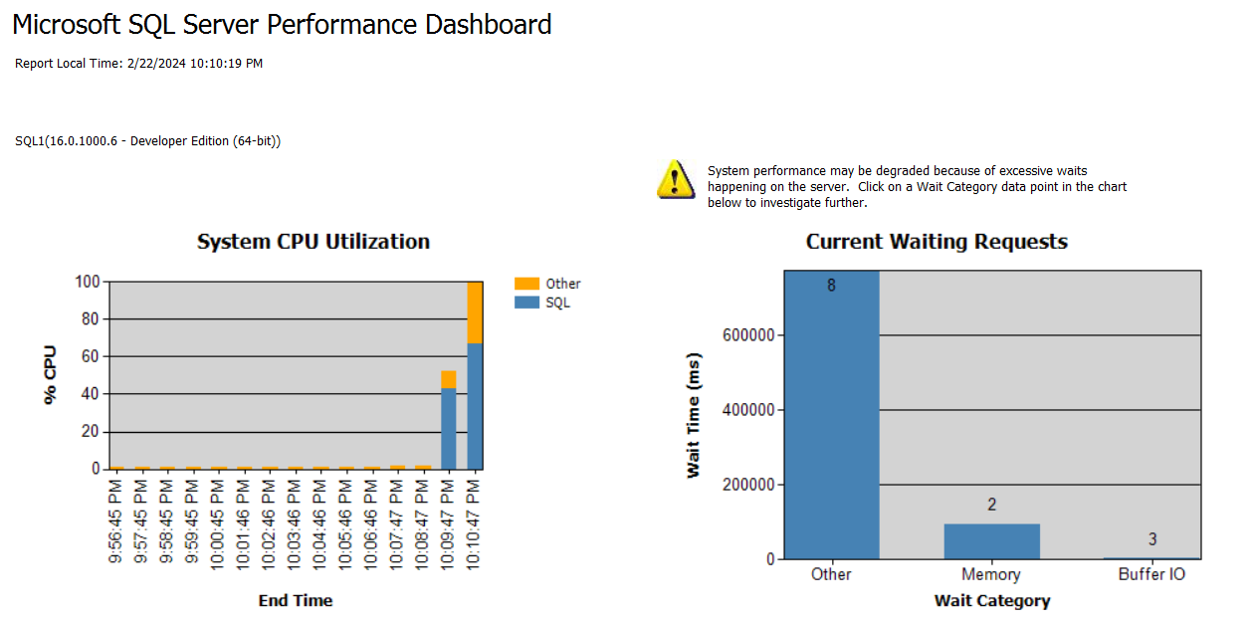
Performance Dashboard

Slide 8
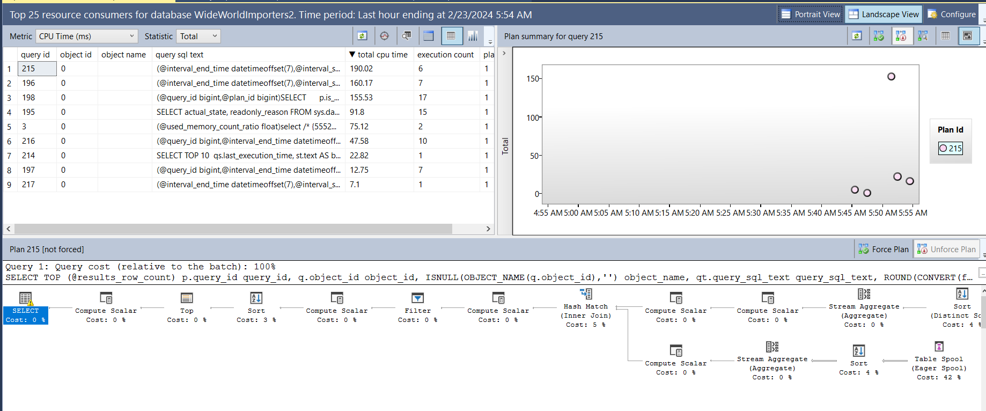
Query Store

Slide 9
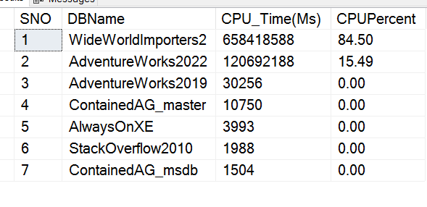
T-SQL/DMVs - CPU usage per database
Note: Only for currently cached plans
WITH DB_CPU AS
(SELECT DatabaseID,
DB_Name(DatabaseID)AS [DatabaseName],
SUM(total_worker_time)AS [CPU_Time(Ms)]
FROM sys.dm_exec_query_stats AS qs
CROSS APPLY(SELECT CONVERT(int, value)AS [DatabaseID]
FROM sys.dm_exec_plan_attributes(qs.plan_handle)
WHERE attribute =N'dbid')AS epa GROUP BY DatabaseID)
SELECT ROW_NUMBER()OVER(ORDER BY [CPU_Time(Ms)] DESC)AS [SNO],
DatabaseName AS [DBName], [CPU_Time(Ms)],
CAST([CPU_Time(Ms)] * 1.0 /SUM([CPU_Time(Ms)]) OVER()* 100.0 AS DECIMAL(5, 2))AS [CPUPercent]
FROM DB_CPU
WHERE DatabaseID > 4 -- system databases
AND DatabaseID <> 32767 -- ResourceDB
ORDER BY SNO OPTION(RECOMPILE)

Slide 10
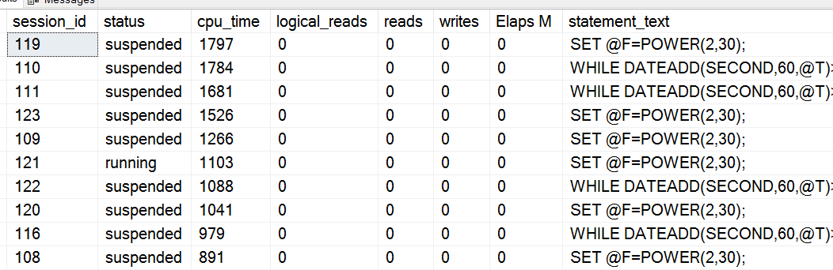
T-SQL / DMVs: Top 10 most CPU-expensive queries
(Currently running)
SELECT TOP 10 s.session_id,
r.status,
r.cpu_time,
r.logical_reads,
r.reads,
r.writes,
r.total_elapsed_time / (1000 * 60) 'Elaps M',
SUBSTRING(st.TEXT, (r.statement_start_offset / 2) + 1,
((CASE r.statement_end_offset
WHEN -1 THEN DATALENGTH(st.TEXT)
ELSE r.statement_end_offset
END - r.statement_start_offset) / 2) + 1) AS statement_text,
COALESCE(QUOTENAME(DB_NAME(st.dbid)) + N'.' + QUOTENAME(OBJECT_SCHEMA_NAME(st.objectid, st.dbid))
+ N'.' + QUOTENAME(OBJECT_NAME(st.objectid, st.dbid)), '') AS command_text,
r.command,
s.login_name,
s.host_name,
s.program_name,
s.last_request_end_time,
s.login_time,
r.open_transaction_count
FROM sys.dm_exec_sessions AS s
JOIN sys.dm_exec_requests AS r ON r.session_id = s.session_id CROSS APPLY sys.Dm_exec_sql_text(r.sql_handle) AS st
WHERE r.session_id != @@SPID
ORDER BY r.cpu_time DESC

Slide 11
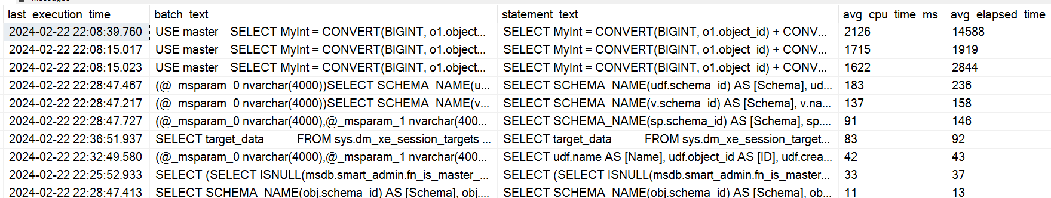
T-SQL / DMVs: Top 10 most CPU-expensive queries
(Historical)
SELECT TOP 10 qs.last_execution_time, st.text AS batch_text,
SUBSTRING(st.TEXT, (qs.statement_start_offset / 2) + 1, ((CASE qs.statement_end_offset WHEN - 1 THEN DATALENGTH(st.TEXT) ELSE qs.statement_end_offset END - qs.statement_start_offset) / 2) + 1) AS statement_text,
(qs.total_worker_time / 1000) / qs.execution_count AS avg_cpu_time_ms,
(qs.total_elapsed_time / 1000) / qs.execution_count AS avg_elapsed_time_ms,
qs.total_logical_reads / qs.execution_count AS avg_logical_reads,
(qs.total_worker_time / 1000) AS cumulative_cpu_time_all_executions_ms,
(qs.total_elapsed_time / 1000) AS cumulative_elapsed_time_all_executions_ms
FROM sys.dm_exec_query_stats qs
CROSS APPLY sys.dm_exec_sql_text(sql_handle) st
ORDER BY(qs.total_worker_time / qs.execution_count) DESC

Slide 12
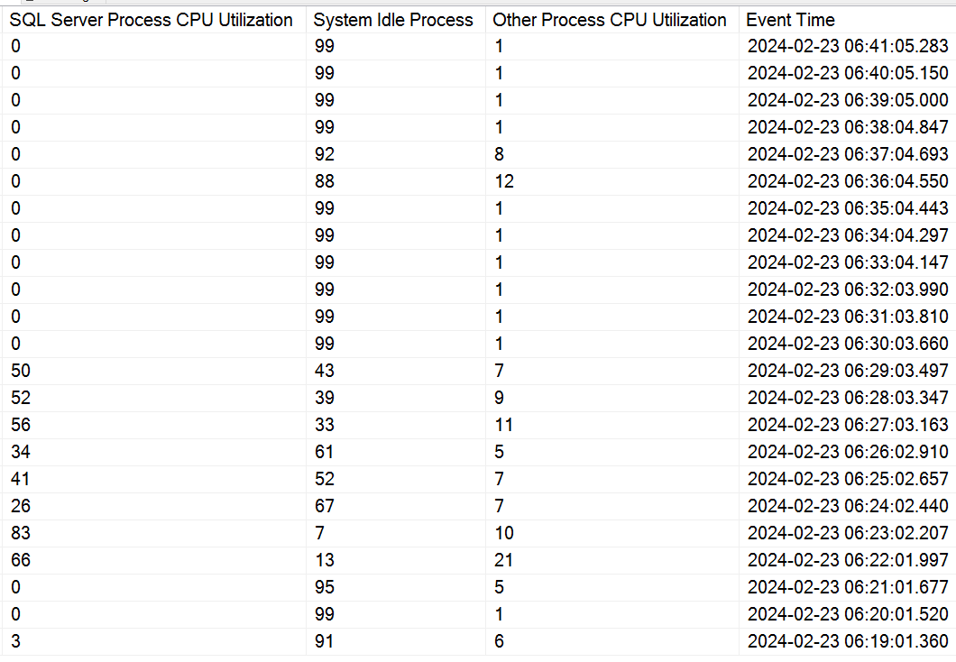
Ring Buffer:
What if high CPU condition happened in the past, but things are normal now?
DECLARE @ts_now bigint = (SELECT ms_ticks FROM sys.dm_os_sys_info WITH (NOLOCK));
SELECT TOP(256) SQLProcessUtilization AS [SQL Server Process CPU Utilization],
SystemIdle AS [System Idle Process],
100 - SystemIdle - SQLProcessUtilization AS [Other Process CPU Utilization],
DATEADD(ms, -1 * (@ts_now - [timestamp]), GETDATE()) AS [Event Time]
FROM (SELECT record.value('(./Record/@id)[1]', 'int') AS record_id,
record.value('(./Record/SchedulerMonitorEvent/SystemHealth/SystemIdle)[1]', 'int')
AS [SystemIdle],
record.value('(./Record/SchedulerMonitorEvent/SystemHealth/ProcessUtilization)[1]', 'int')
AS [SQLProcessUtilization], [timestamp]
FROM (SELECT [timestamp], CONVERT(xml, record) AS [record]
FROM sys.dm_os_ring_buffers WITH (NOLOCK)
WHERE ring_buffer_type = N'RING_BUFFER_SCHEDULER_MONITOR'
AND record LIKE N'%<SystemHealth>%') AS x) AS y
ORDER BY record_id DESC OPTION (RECOMPILE);

Slide 13
Honorable Mention
3rd party community scripts and apps
sp_whoisactive
sp_Blitz
Query Performance Insights
dbatools
Licensed Monitoring Tools

Slide 14
Appendix
Links to community scripts
SP WHOISACTIVE (Adam Machanic)
https://whoisactive.com/downloads/
SP Blitz (Brent Ozar)
https://www.brentozar.com/blitz/
Query Performance Insights (Jovan Popovic)
GitHub - JocaPC/qpi: Query Performance Insight - analyze performance of your SQL Server Database Engine
Dbatools / Get-DbaCpuUsage (Chrissy LeMaire)
dbatools docs | Get-DbaCpuUsage

Slide 15

Demo

